Slide 1


Rakibul Hasan Rajib | 1921834
Md. Mahmud Hassan Rabby | 1731609
Misbah Ahmed | 1510998
Tamima Sigma | 1630436
Hasan Ahmed | 1610266
Udipta Mazumder | 1710138
Md Rakib Hossain | 1731400
Database Management System
Section : 1
Group :1

Slide 2




As–Is System
Rich Picture(As-is)
Six Element Analysis
Business Process Diagram
Problem Analysis

Slide 3
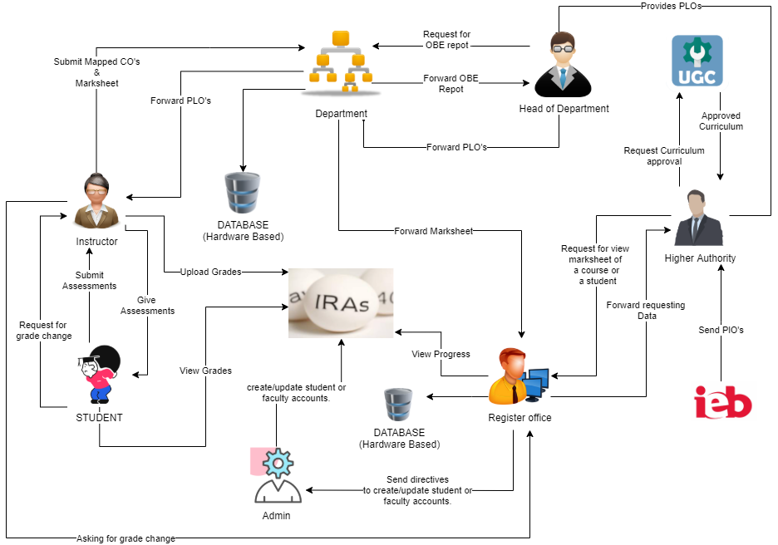
Rich Picture (AS-IS)

Slide 4
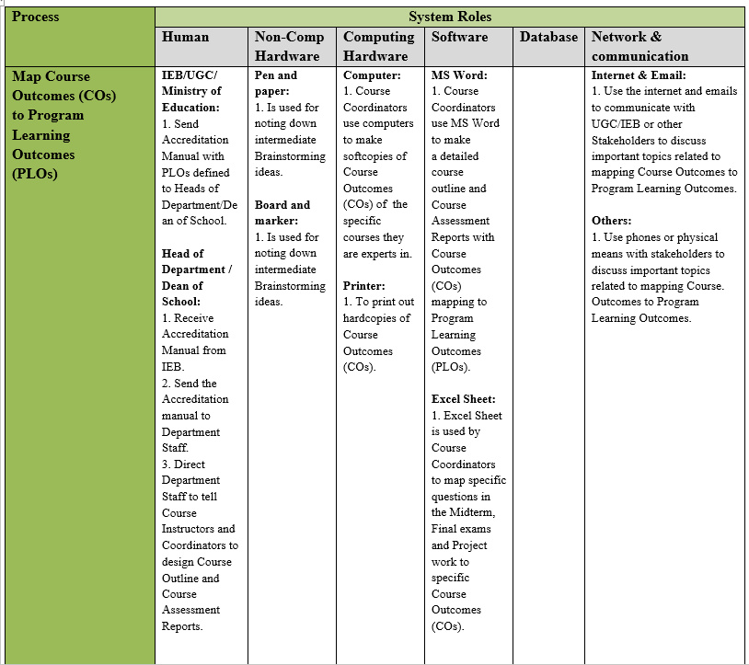
Six Element Analysis (As-is)

Slide 5
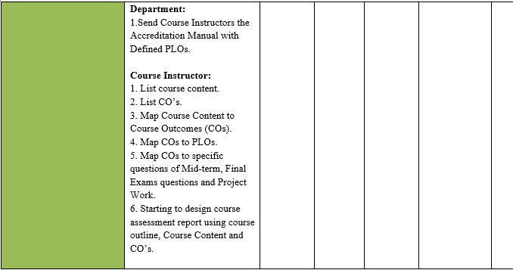

Slide 6
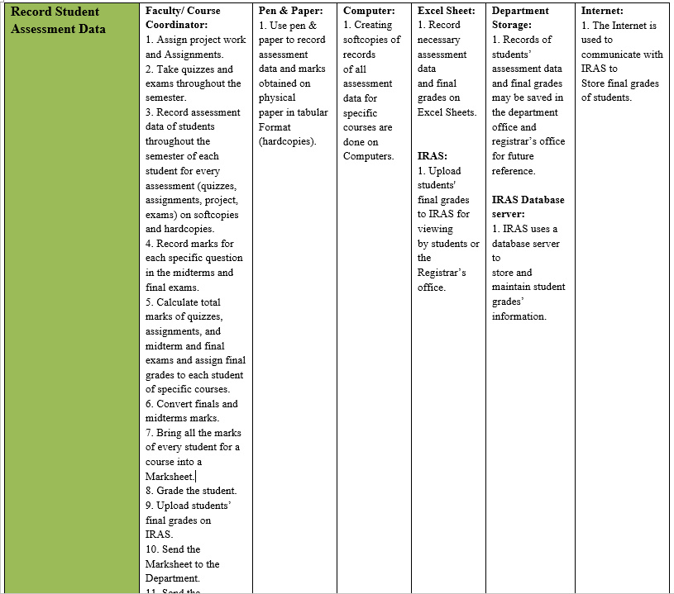

Slide 7
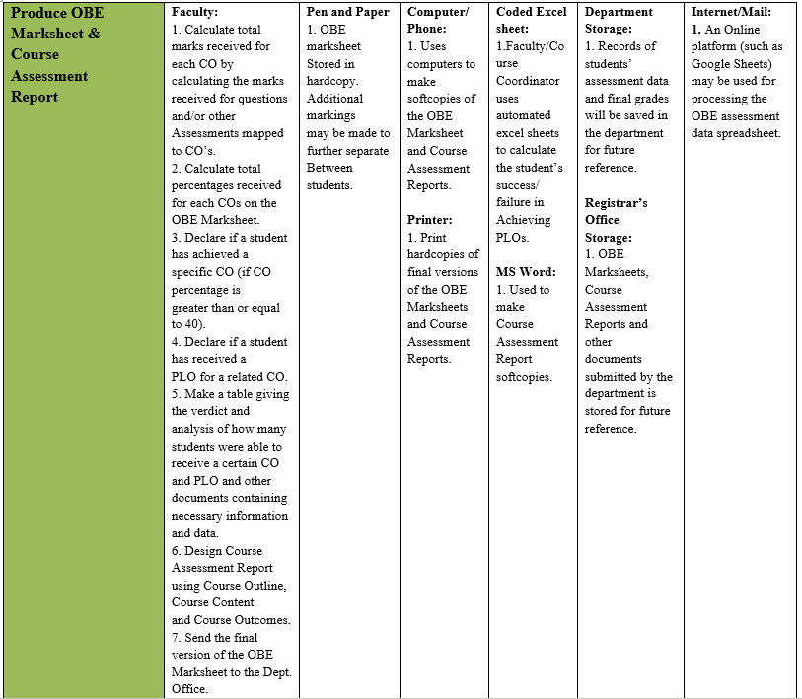

Slide 8


Slide 9
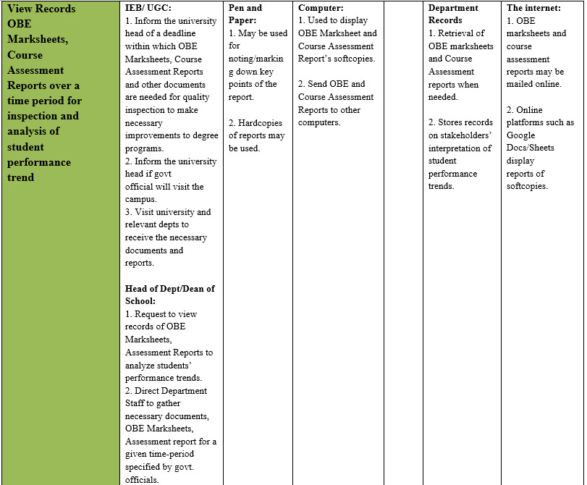

Slide 10


Slide 11
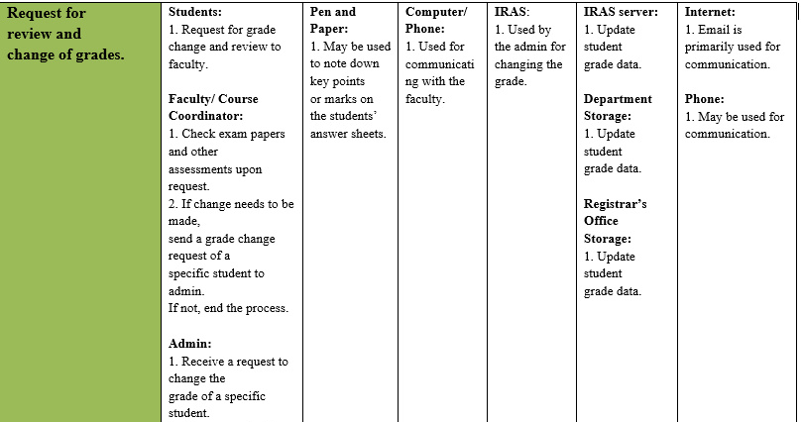

Slide 12
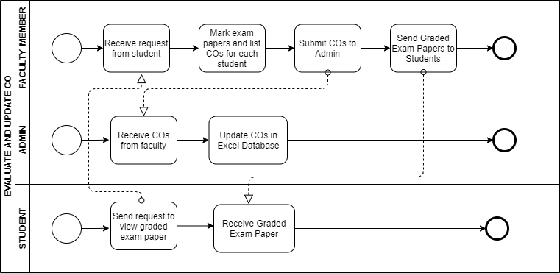
Process Diagram (As-Is)

Slide 13
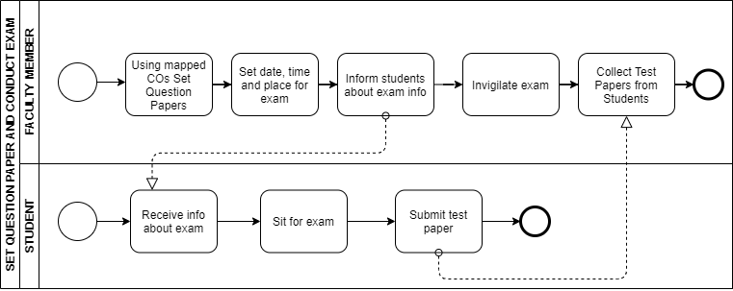

Slide 14
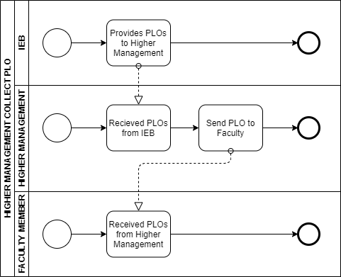

Slide 15
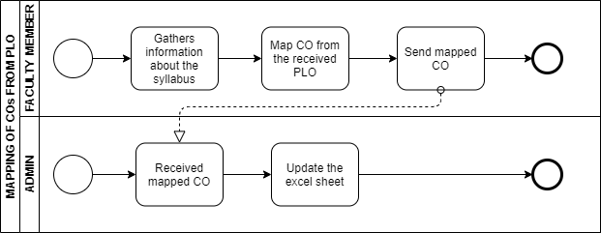

Slide 16
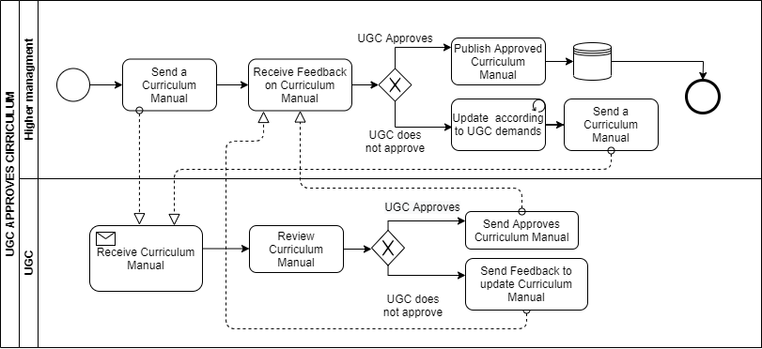

Slide 17
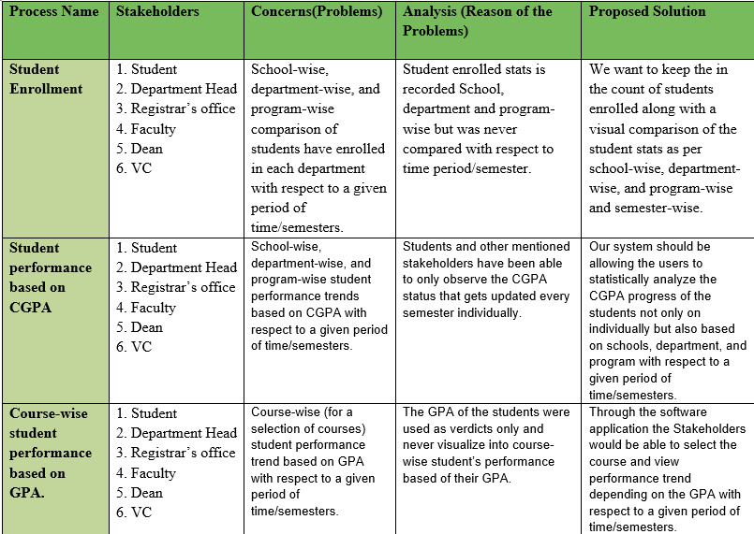
Problem Analysis

Slide 18
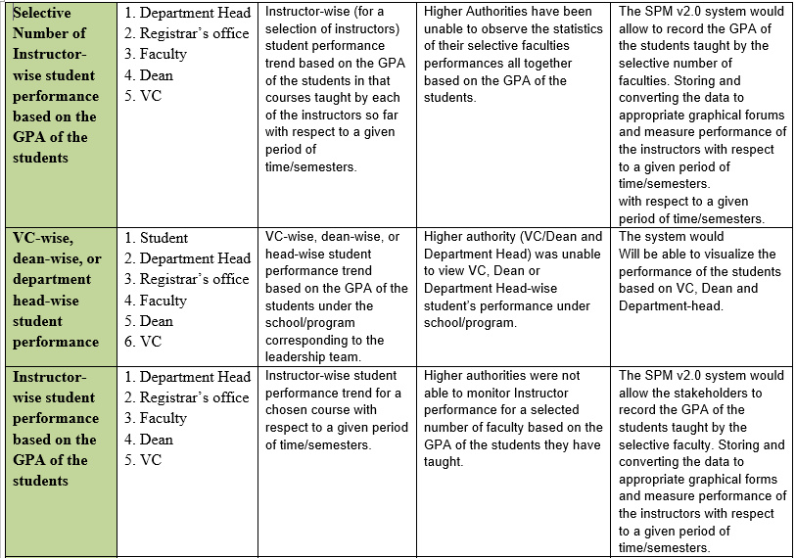

Slide 19
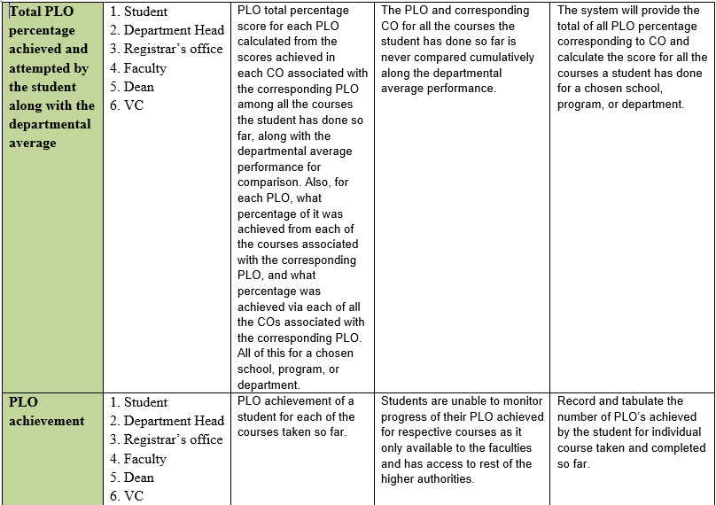

Slide 20
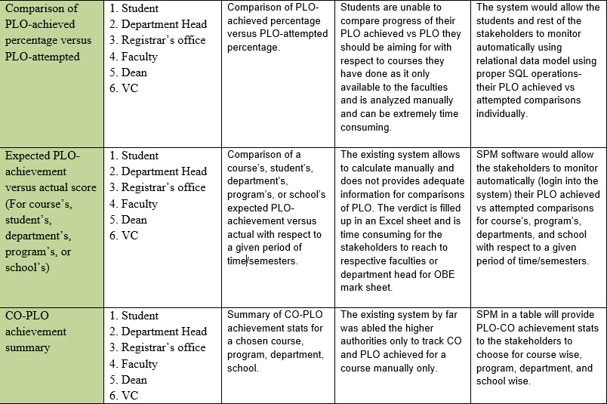

Slide 21

Proposed System
Rich Picture(As-is)
Six-Element Analysis
Business Process Diagram
Solution

Slide 22
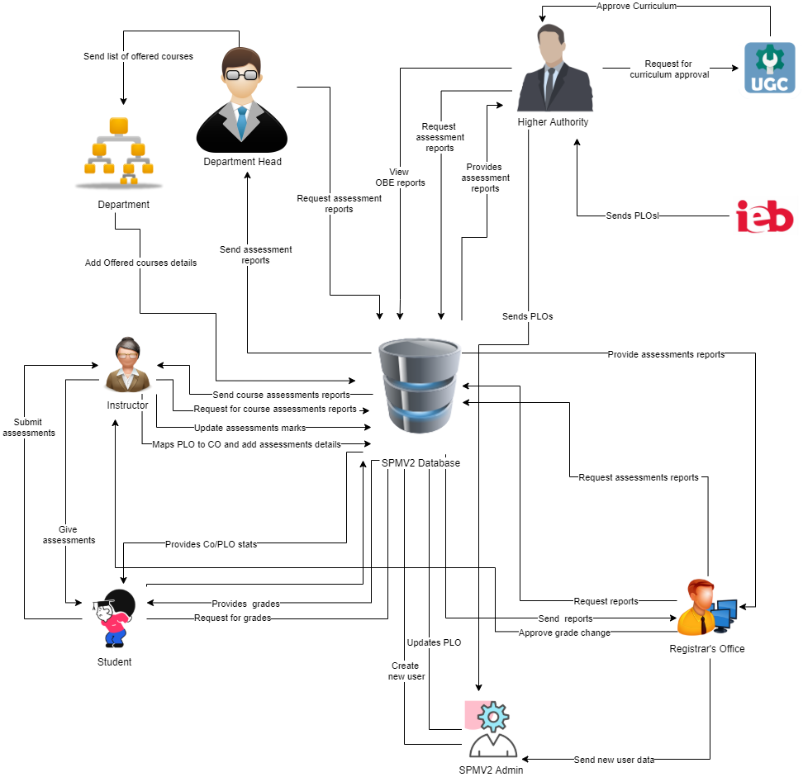
Rich Picture (To-be)

Slide 23
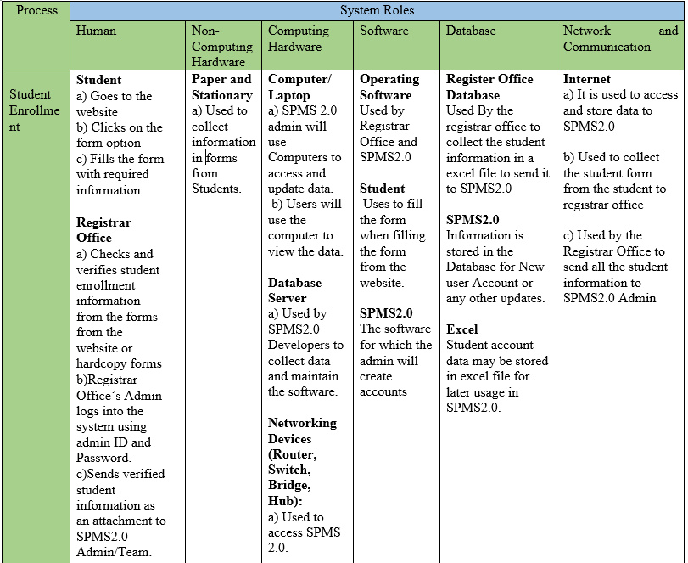
Six Element Analysis (To-be)

Slide 24
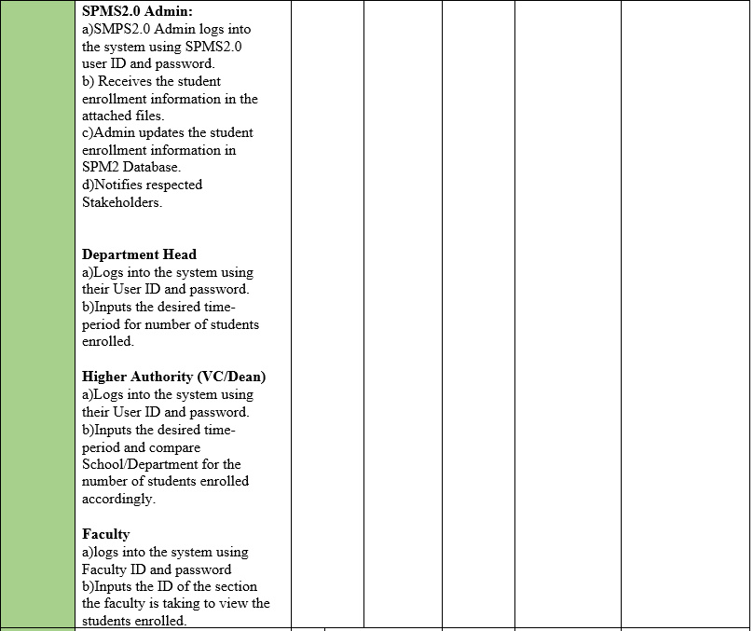

Slide 25
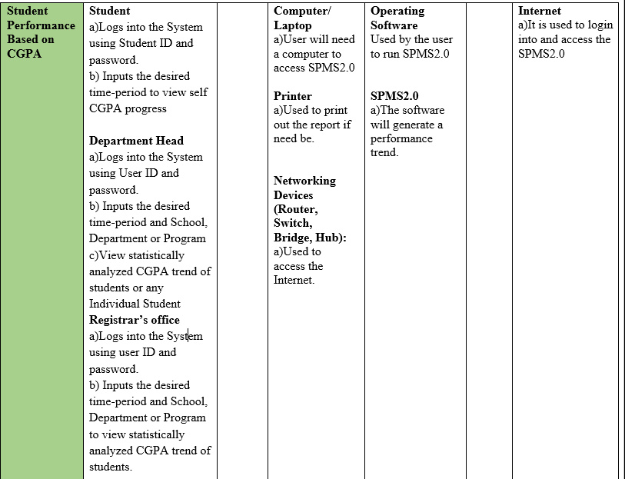

Slide 26
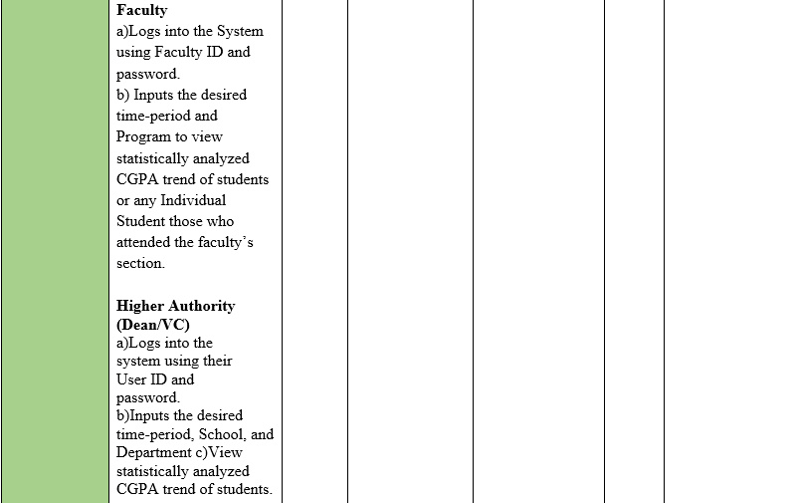

Slide 27
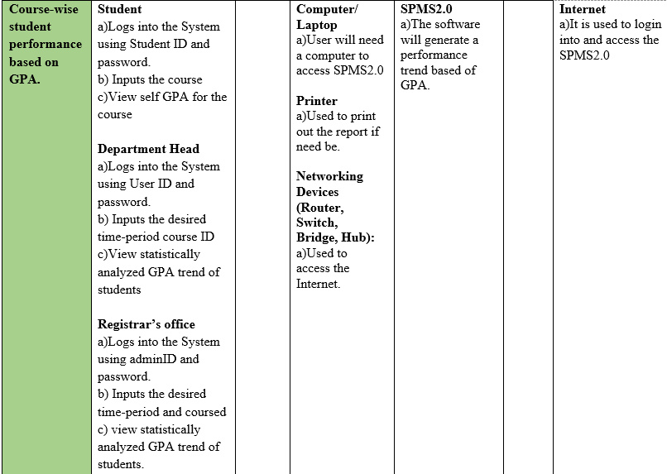

Slide 28
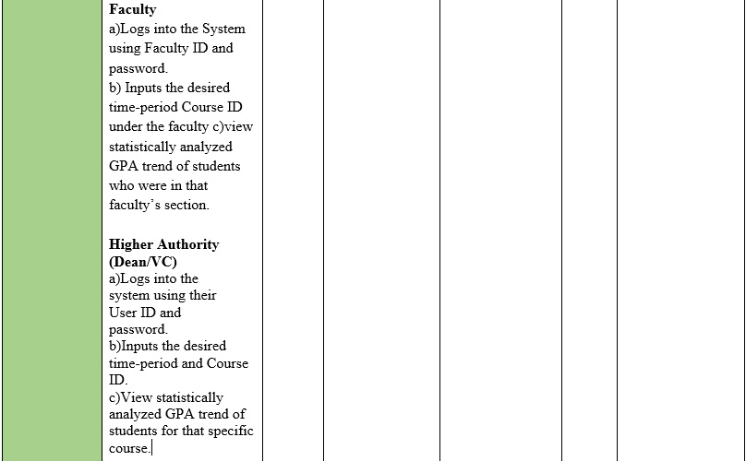

Slide 29
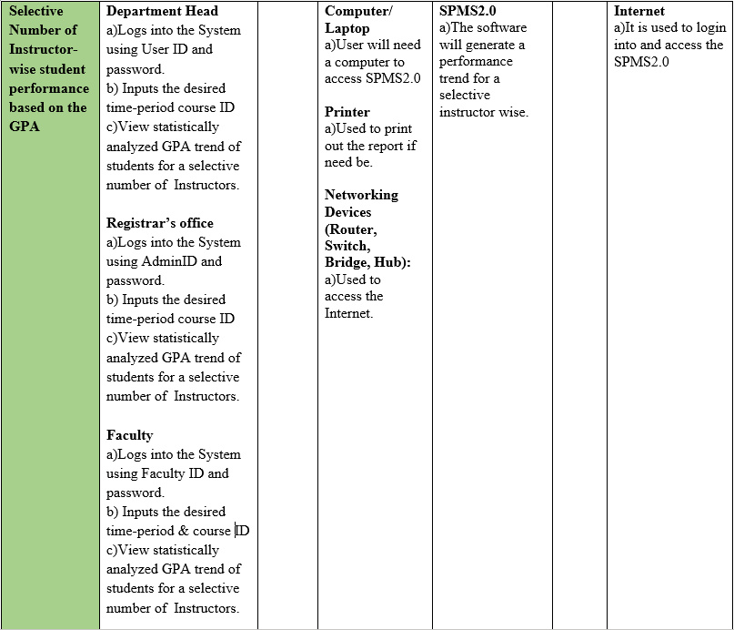

Slide 30


Slide 31
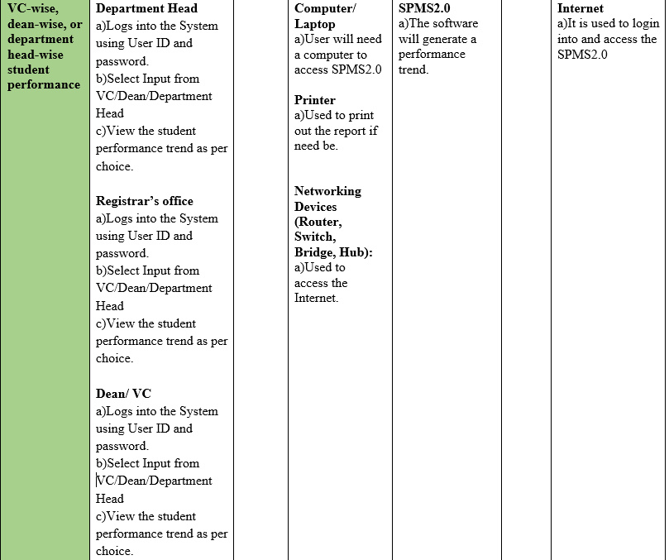

Slide 32
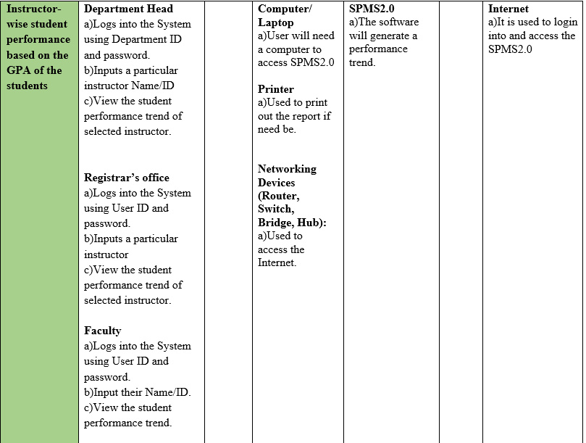

Slide 33
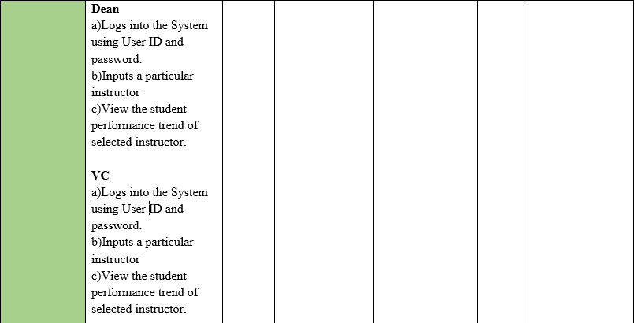

Slide 34
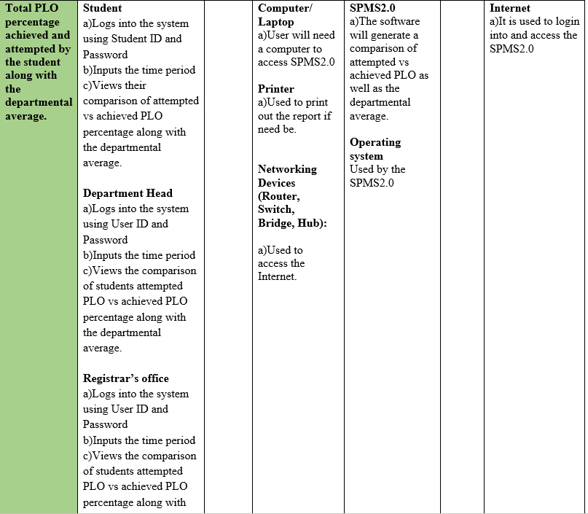

Slide 35
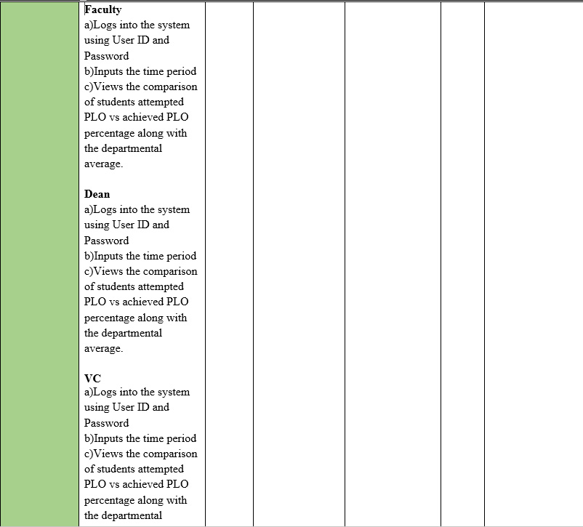

Slide 36
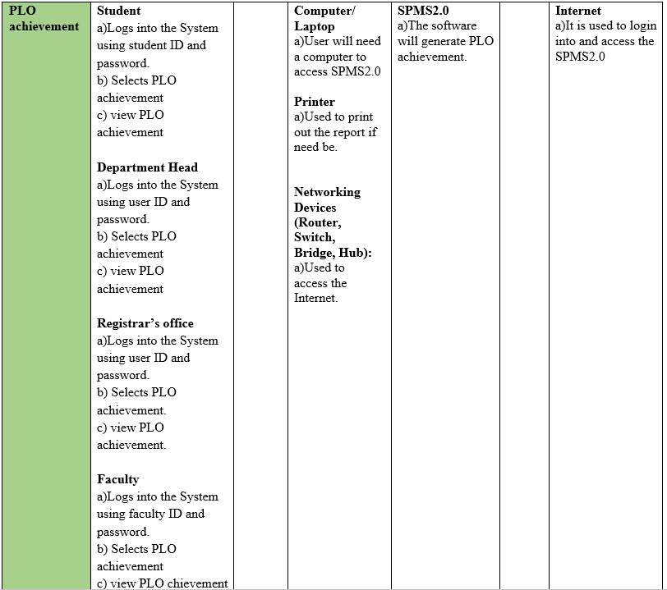

Slide 37
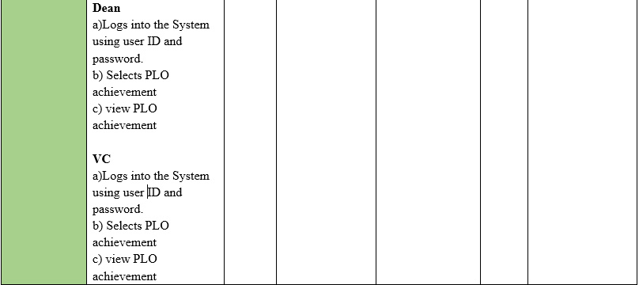

Slide 38
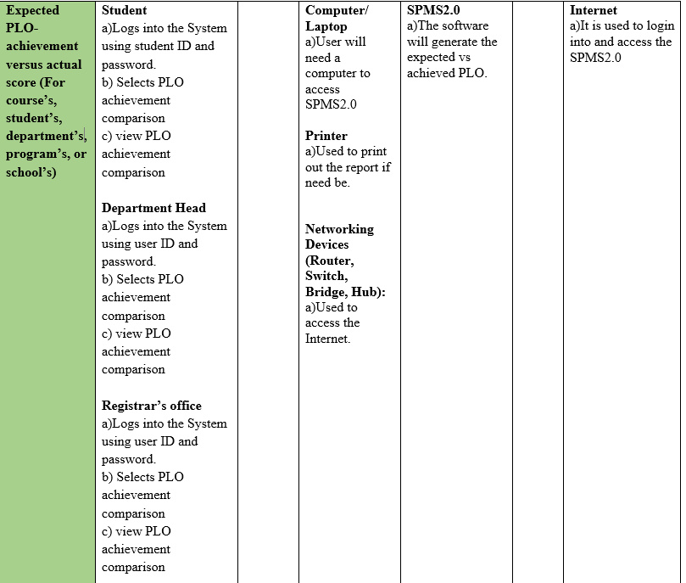

Slide 39
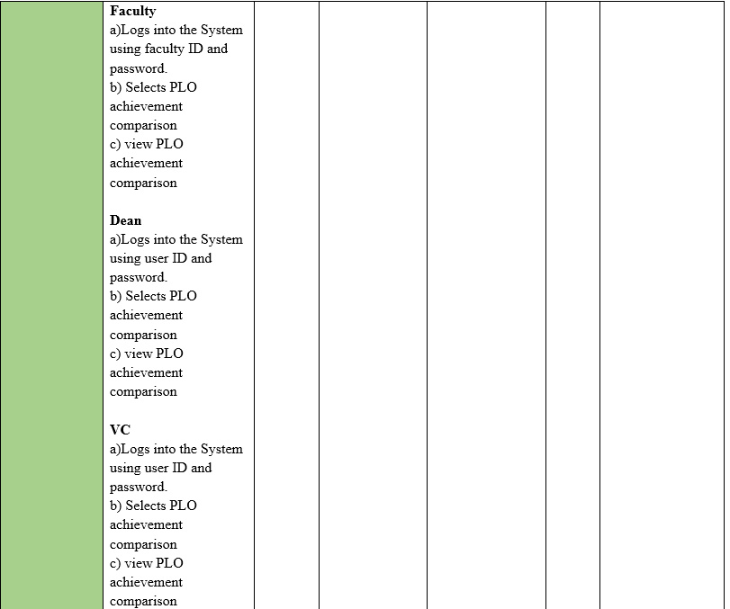

Slide 40
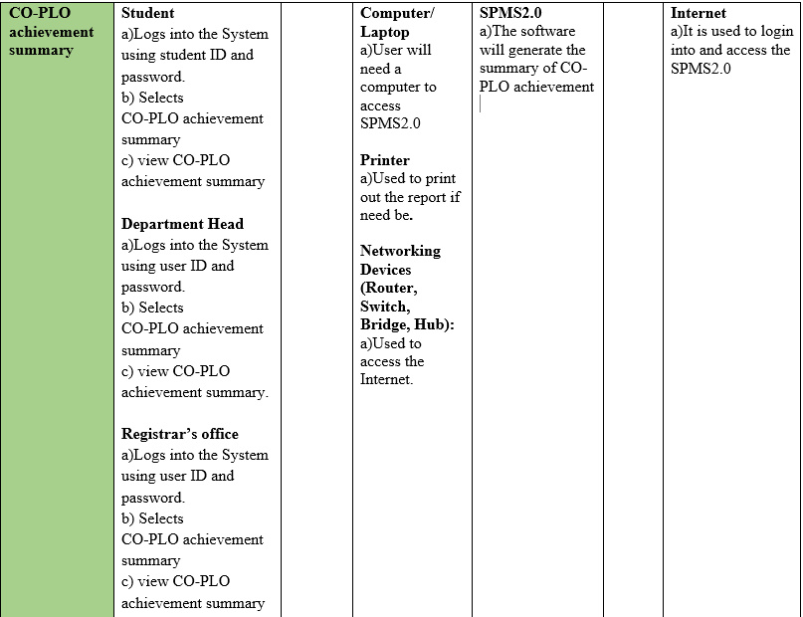

Slide 41
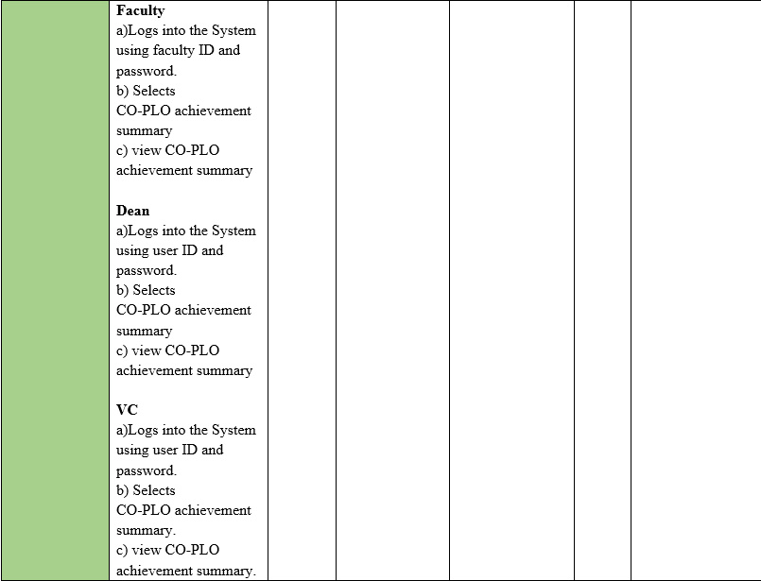

Slide 42
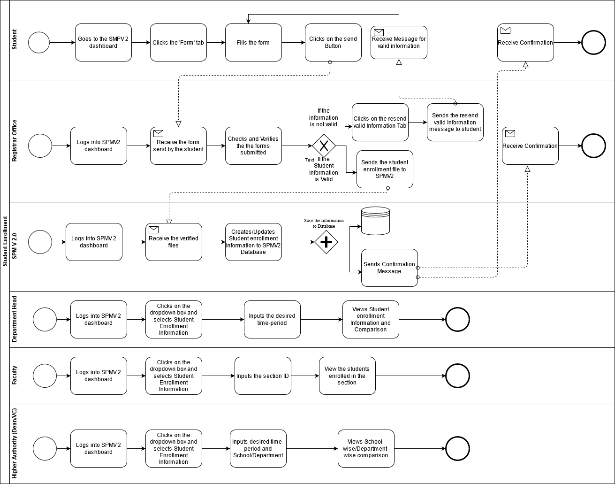
Process
Diagram
(To-Be)

Slide 43
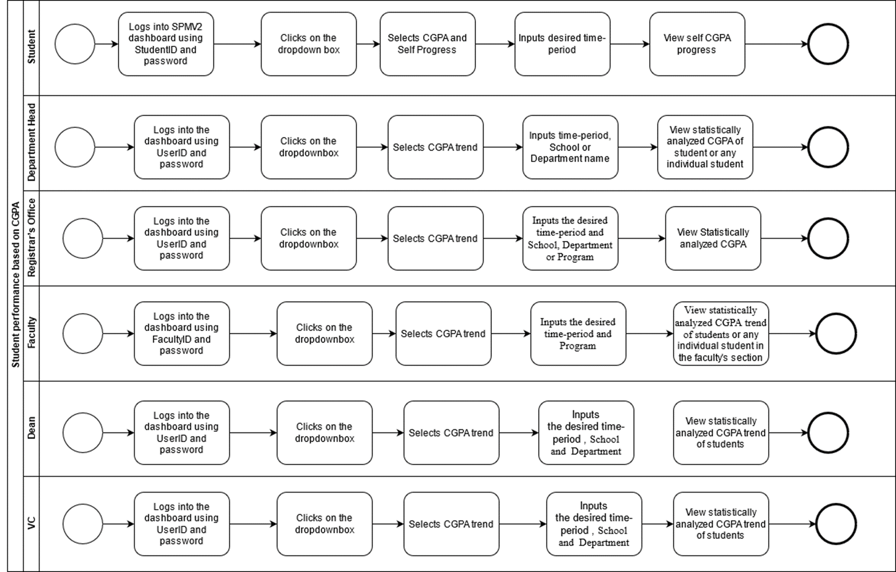

Slide 44
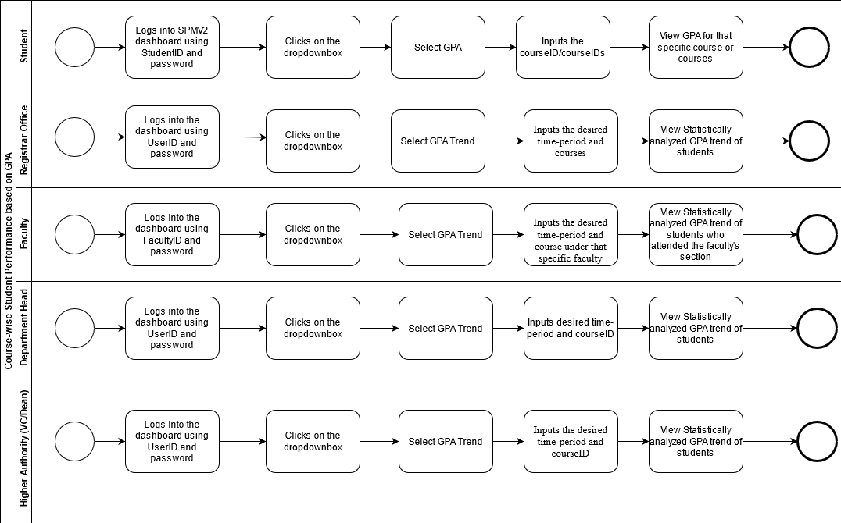

Slide 45
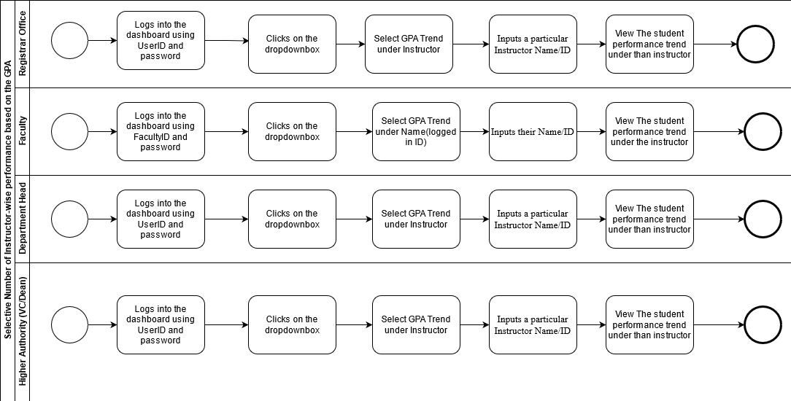

Slide 46
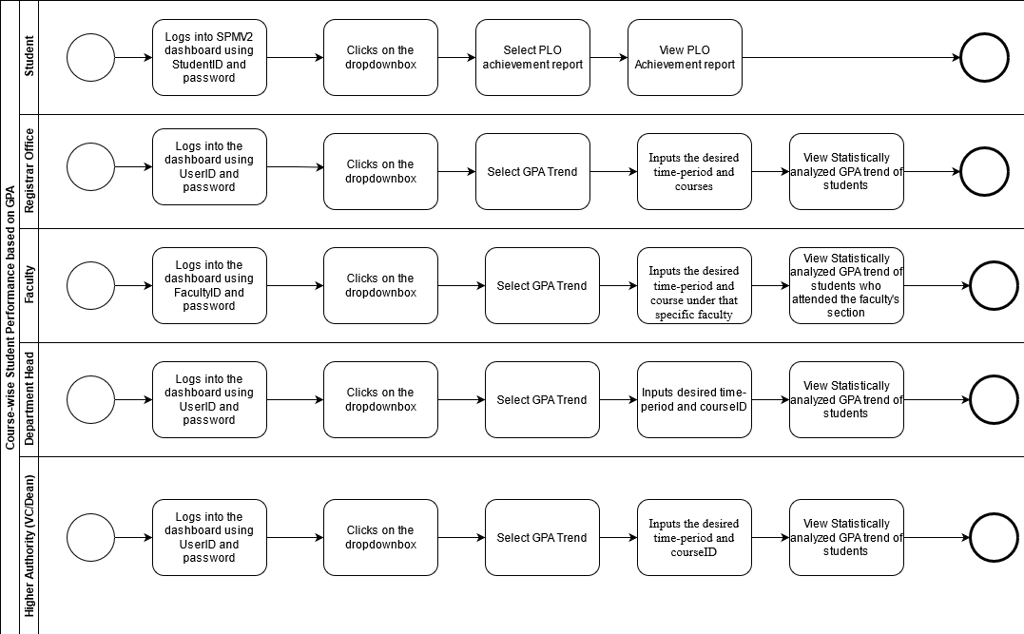

Slide 47
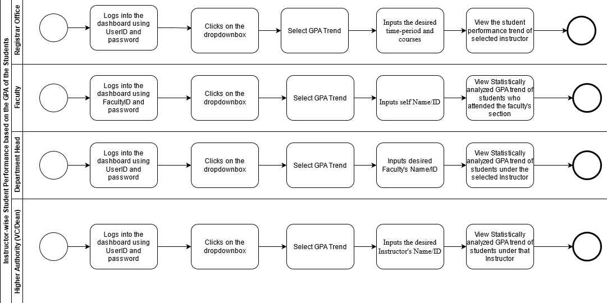

Slide 48
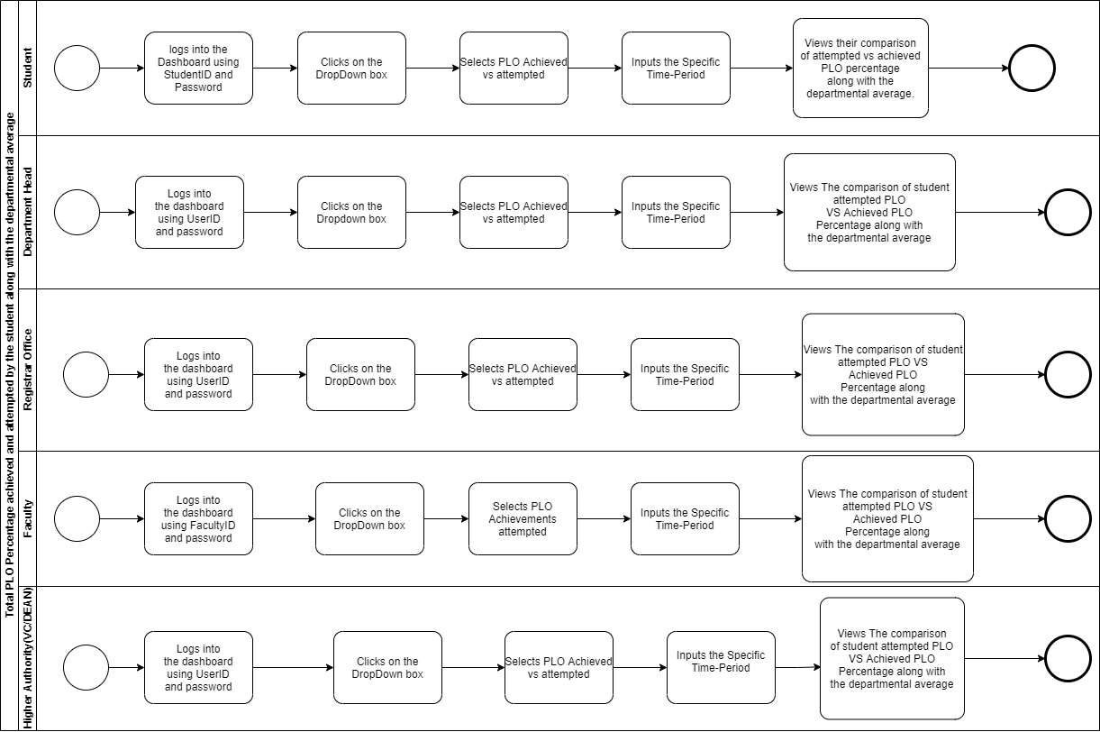

Slide 49
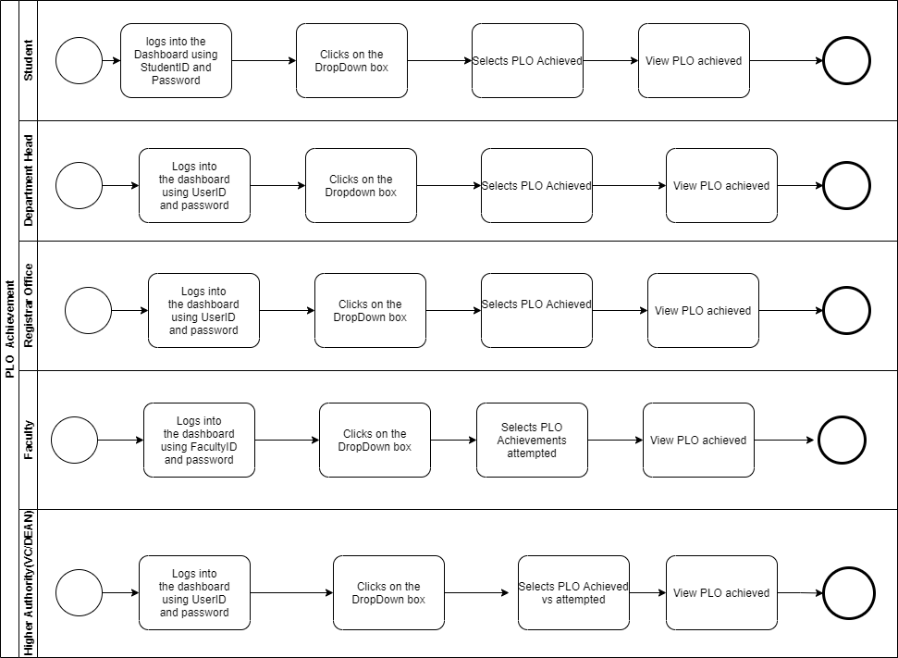

Slide 50
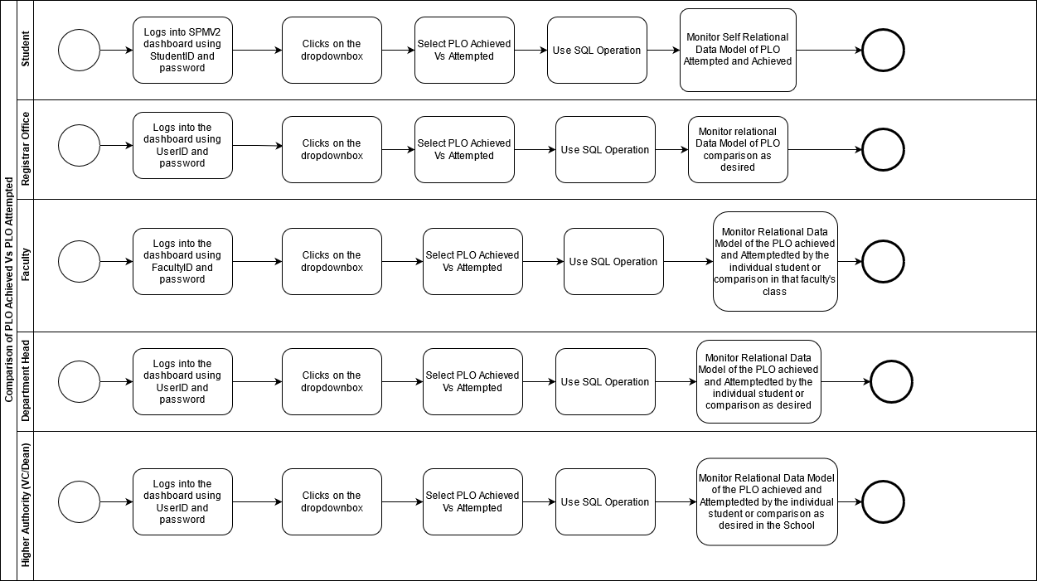

Slide 51
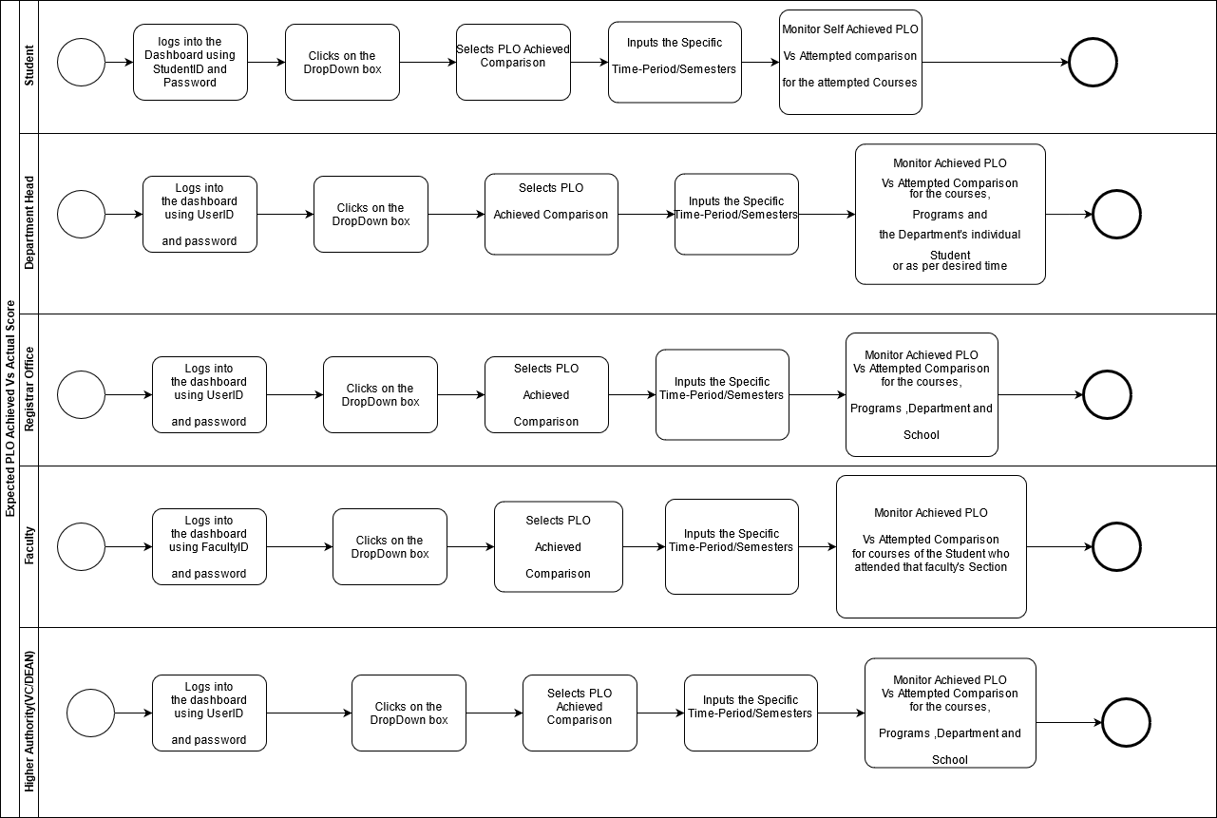

Slide 52
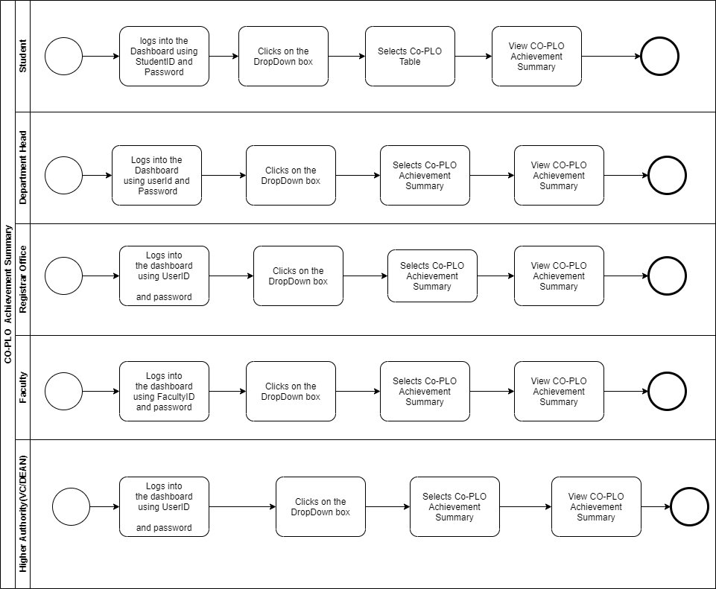

Slide 53
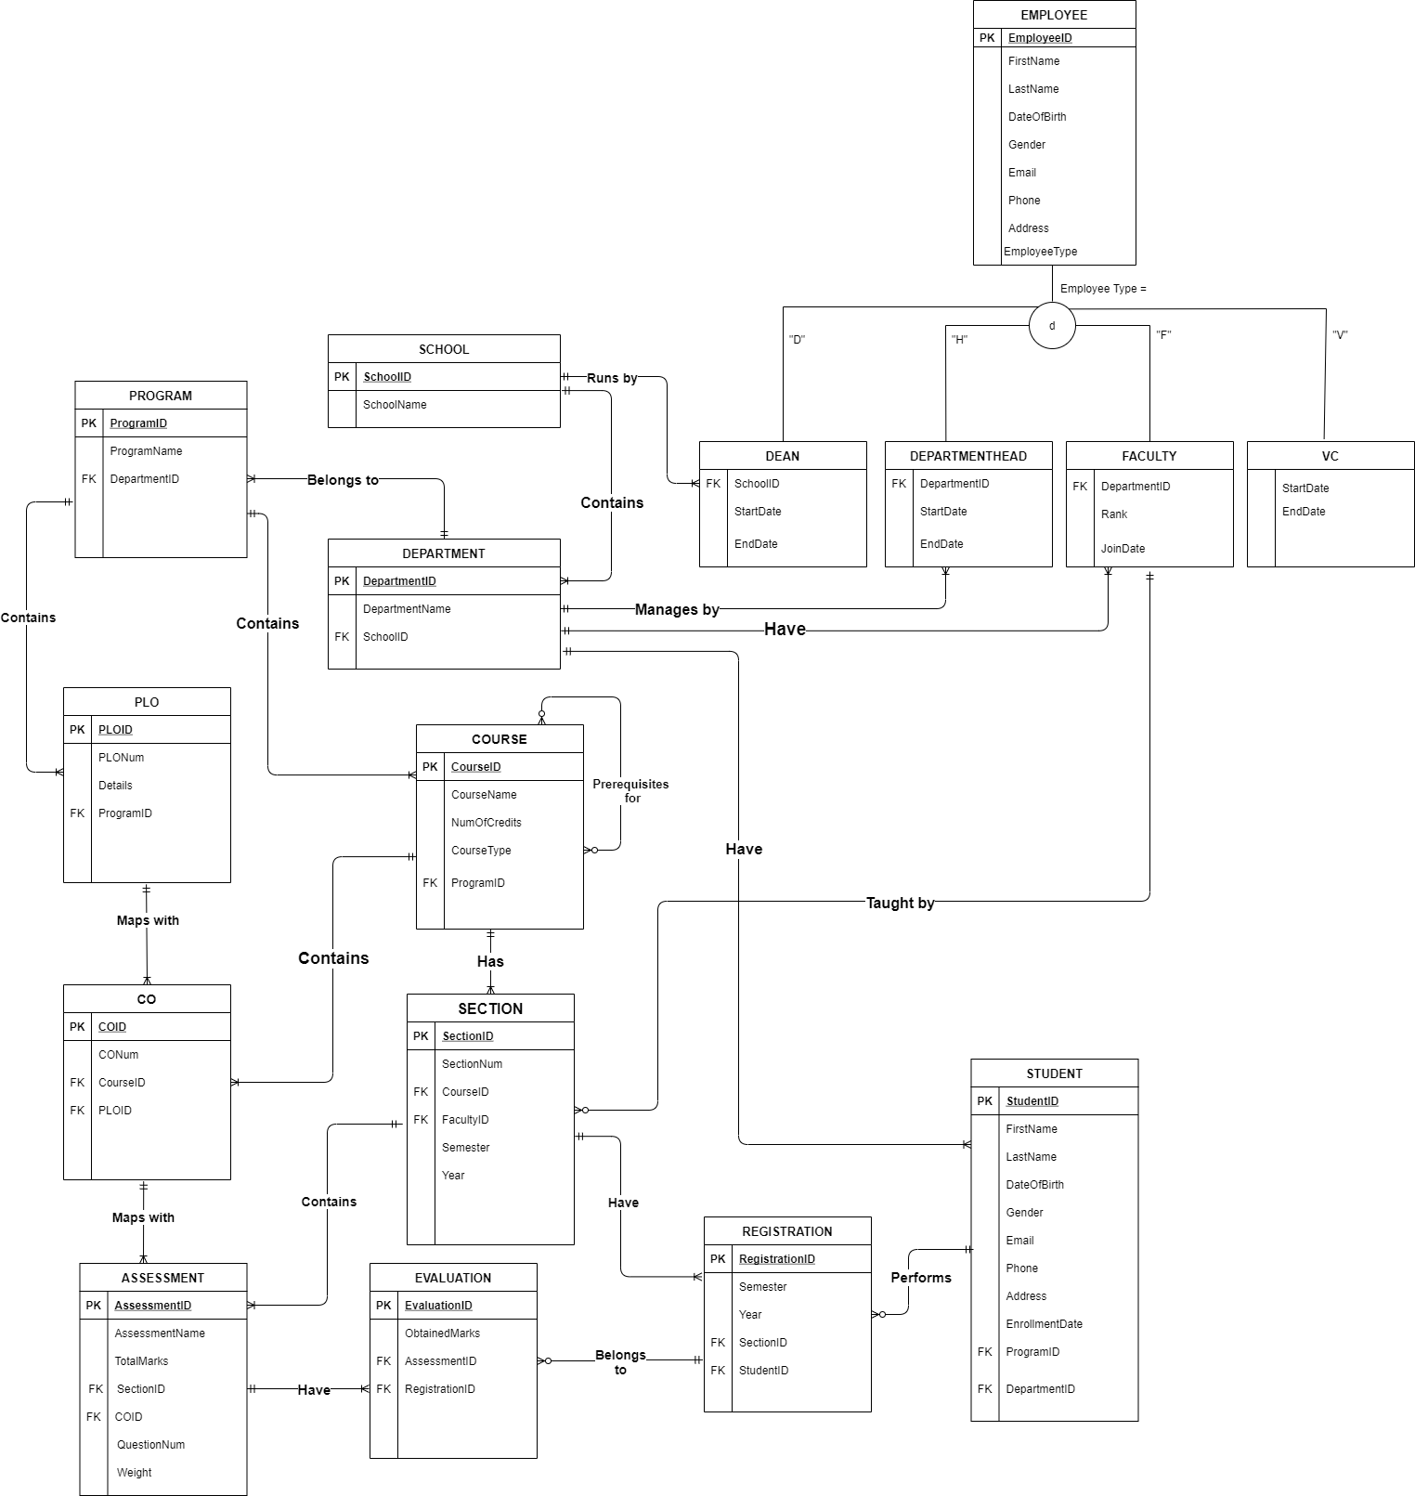
ERD

Slide 54
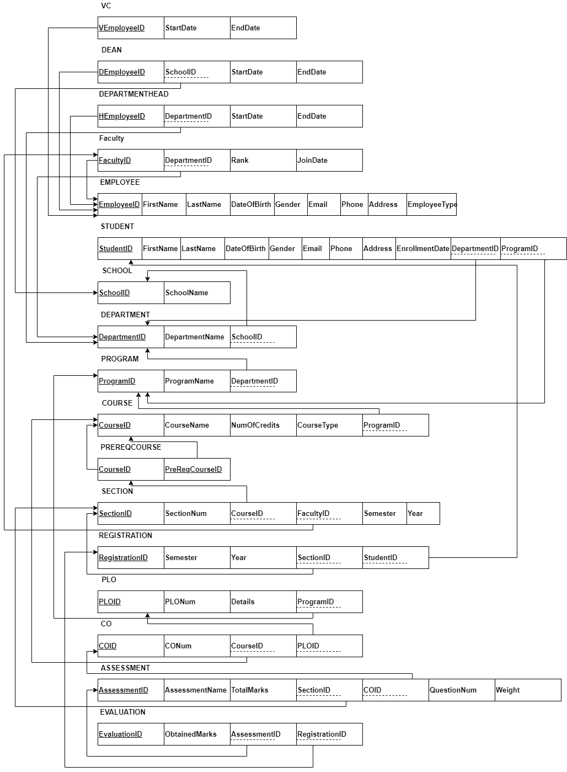
ERD to Relations

Slide 55
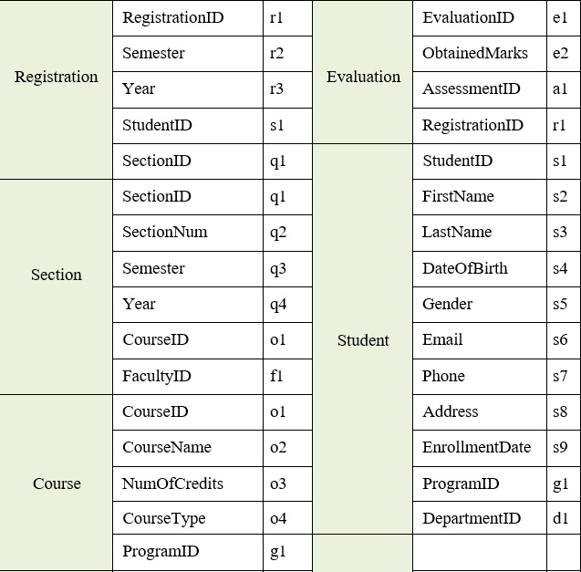
NORMALIZATION

Slide 56
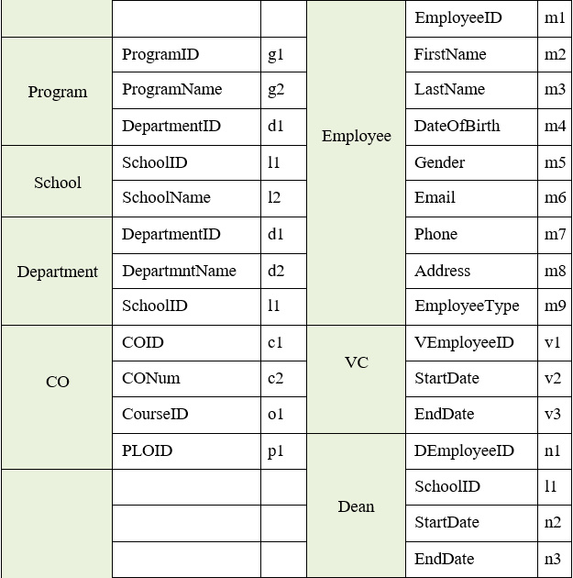

Slide 57


Slide 58


Slide 59

1 NF

Slide 60

2 NF

Slide 61

3 NF
BCNF: All determinants are candidate keys. There is no determinant that is not a unique identifier. Here, all the relations already are in BCNF.

Slide 62

Implementation

Slide 63

Log In Dashboard of SPMS2.0
Front End: HTML, Java Script, Bootstrap and CSS
Local hosting: spmapp​
Backend: Python, Django

Slide 64


Slide 65


Slide 66


Slide 67


Slide 68


Slide 69


Slide 70


Slide 71


Slide 72


Slide 73


Slide 74


Slide 75


Slide 76


Slide 77


Slide 78


Slide 79


Slide 80


Slide 81


Slide 82


Slide 83


Slide 84


Slide 85


Slide 86


Slide 87


Slide 88


Slide 89


Slide 90


Slide 91


Slide 92


Slide 93


Slide 94


Slide 95


Slide 96


Slide 97
Thank you

